Slide 1

The movement
The Journey from Symmetric to Asymmetric Cryptography

Slide 2
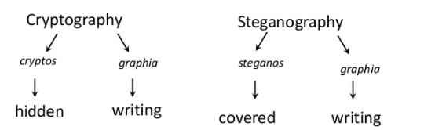
Cryptography vs Steganography
Both terms derived from the Greek
Origin of written language?
(Singh, S. (2001). The code book: how to make it, break it, hack it, crack it. New York: Delacorte Press)

Slide 3
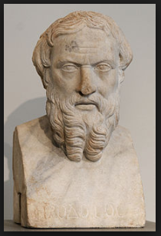
STEGANOGRAPHY
The tithymalus plant
Ancient Chinese – tiny ball covered in wax
Herodotus – “The father of history”
Wooden table
Messenger head
(Singh, S. (2001). The code book: how to make it, break it, hack it, crack it. New York: Delacorte Press)
Figure 1: Herodotus (Wikipedia, 2018)

Slide 4
Cryptography
Two branches of Cryptography:
Transposition
Substitution
Types of Encryption:
Symmetric (also called “secret key”)
Asymmetric (also called “public key”)
The aim of cryptography is not to hide the existence of a message, but rather to hide its meaning, a process known as encryption.
(Singh, S. (2001). The code book: how to make it, break it, hack it, crack it. New York: Delacorte Press)

Slide 5
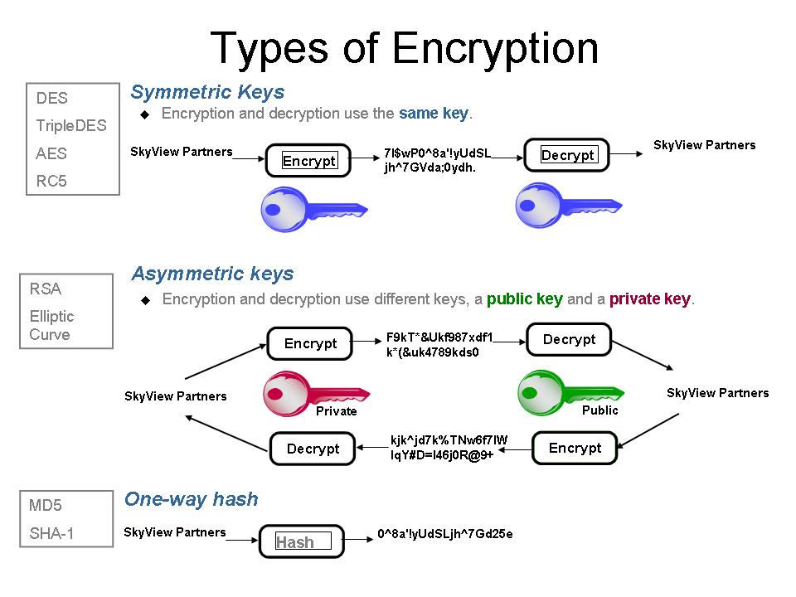
Figure 2: Encryption (TrickSter, 2015)

Slide 6
Cryptanalysis
Deals with the study of cipher text, ciphers and cryptosystems with the aim of understanding how they work and finding ways to break or improve their effectiveness. The people who do these studies are called cryptanalysts and conduct these studies without any prior knowledge of what may be in the plaintext, the key used or sometimes even the algorithm.
Rouse,Margaret(2015), Cryptanalysis, Retrieved from http://searchsecurity.techtarget.com/definition/cryptanalysis

Slide 7
What is Symmetric Cryptography
Symmetric Cryptography deals with encrypting and decrypting messages using a single key.
Symmetric Cryptography is also known as Symmetric-Key Algorithm
Branches of Symmetric Cryptography include Transposition and Substitution

Slide 8

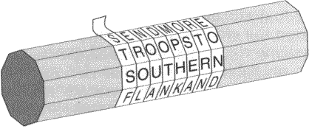
Transposition
The method of rearranging the letters of a word or sentence
There can be over 50x10^20 combinations
Transposition can get incredible difficult
Popular methods of doing this were by the Rail fence and the Spartan Scytale
Figure 4: (Singh, S. (2001). The code book: how to make it, break it, hack it, crack it. New York: Delacorte Press.)

Slide 9
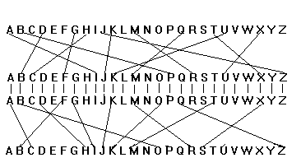
Substitution
The art of exchanging in an alphabet
Some forms of substitution include
Substitution Cipher (Letter Pairing)
The Caesar Shift Cipher
Figure 5: (Singh, S. (2001). The code book: how to make it, break it, hack it, crack it. New York: Delacorte Press.)
Figure 3: The Principle of the Enigma (Codes and Ciphers, n.d.)

Slide 10
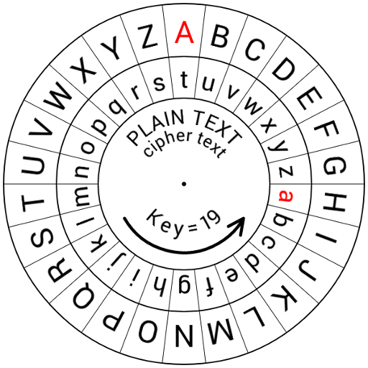
Famous use of substitution
One of the most famous uses for substitution was the Caesar Shift Cipher
Caesar used this cipher to send instructions

Slide 11
Cons of Symmetric Cryptography
If the Key is found out
Decryption of Any future messages
Fabrication of Messages
Difficulty to get the keys across

Slide 12
War driven cryptography
World war II began in September 1, 1939
The Second World War was started by Germany in an unprovoked attack on Poland. Britain and France declared war on Germany after Hitler had refused to abort his invasion of Poland.
Many codes and chippers were used

Slide 13
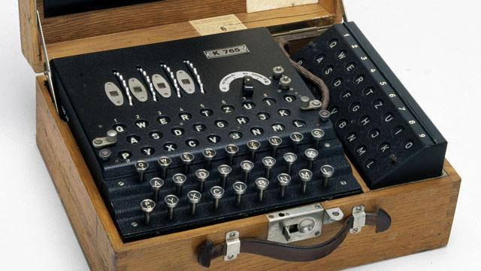
Enigma
The most significant event was the breaking of the Enigma cipher
Arthur Scherbius created the Enigma at the end of world war I 1918 (20 years)
The first complete break into Enigma was accomplished by Poland around 1932
Figure7: A four-rotor German Enigma cipher machine made during WW2. (BBC, n.d.)

Slide 14
Alan turning
The main focus of Turing’s work at Bletchley was to break the enigma
Turing played a key role in this, inventing – along with fellow code-breaker Gordon Welchman the Bombe machine
He headed the ‘Hut 8’ team at Bletchley, which carried out cryptanalysis of all German naval signals
Turing’s role was pivotal in helping the Allies during the Battle of the Atlantic

Slide 15
Asymmetric Cryptography
The beginning of Asymmetric Cryptography
The Government Communications Headquarters (Founded 1919) tasked James Ellis to look at the key distribution problem in 1969.
In 1973 Clifford Cox thinks of RSA function for asymmetric cryptography.
Roeder, T. (n.d.). Asymmetric-Key Cryptography. (https://www.cs.cornell.edu/courses/cs5430/2013sp/TL04.asymmetric.html

Slide 16
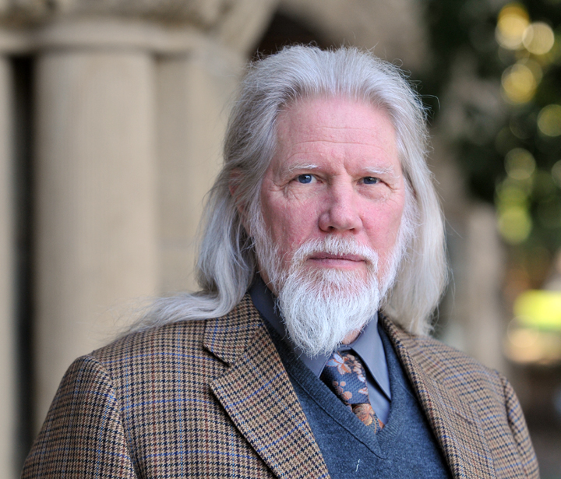
Whitfield Diffie
Bailey Whitfield 'Whit' Diffie is an American cryptographer and one of the pioneers of public-key cryptography.
1975: Whitfield Diffie imagines asymmetric cryptography
Whitfield Diffie and Martie E. Hellman write a paper called New directions in cryptography, in which they describe the idea of asymmetric cryptography
1976: Diffie-Hellman key exchange.
Figure 8: Cryptography Pioneers receive ACM A.M. Turing Award (ACM, 2015)

Slide 17
Asymmetric Cryptography Con’t
1977: (Rivest, Shamir, Adelman) RSA algorithm contributed to the public key encryption being invented.
1978 - Robert McEliece invents the McEliece cryptosystem, the first asymmetric encryption algorithm to use randomization in the encryption process.
Roeder, T. (n.d.). Asymmetric-Key Cryptography. Retrieved from https://www.cs.cornell.edu/courses/cs5430/2013sp/TL04.asymmetric.html

Slide 18
References
Roeder, T. (n.d.). Asymmetric-Key Cryptography. Retrieved from https://www.cs.cornell.edu/courses/cs5430/2013sp/TL04.asymmetric.html
(Singh, S. (2001). The code book: how to make it, break it, hack it, crack it. New York: Delacorte Press)
Rouse,Margaret(2015), Cryptanalysis, Retrieved from http://searchsecurity.techtarget.com/definition/cryptanalysis

Slide 19
IWM Staff (2018), How Alan Turing cracked the Enigma Code, Retrieved from https://www.iwm.org.uk/history/how-alan-turing-cracked-the-enigma-code
World War II Cryptography, Retrieved from https://en.wikipedia.org/wiki/World_War_II_cryptography
Roeder, T. (n.d.). Asymmetric-Key Cryptography. Retrieved from https://www.cs.cornell.edu/courses/cs5430/2013sp/TL04.asymmetric.html

Slide 20

Group Members:
Farnaz Baksh
Shemar Austin
Kim Shing Chong
Dwight Ferguson
Shomari Williams

